Slide 1
Seminar Course Steam turbines in Thermal power plants.
By
Gunda Venkata Sai Jai Harsha.
190C2050003
Mech 19.

Slide 2
Title of the study
Steam turbines in Thermal power plants.

Slide 3
INTRODUCTION
Firstly, what is Thermal power plant ?
Thermal power plants are which converts the heat energy of primary fuels such as coal, to the electric power. In most of the thermal power stations, combustion of primary fuels heats the water and transforms it to steam. The steam drives steam turbines, which eventually generates electricity. Subsequently, the steam is condensed and recycled back into the system. The thermal power stations may use several different types of heat sources, including fossil fuels, nuclear energy, biomass and waste.
In India there are 269 thermal power stations with a total installed capacity of 221,802.59 MW.
As of April 2021, India has a total Thermal installed capacity of 234 GW, of which 53% of the thermal power is obtained from coal and the rest from Lignite, Diesel, and Gas. The private sector generates 47.4% of India's thermal power whereas States and Centre generate 27.1% and 25.5% respectively.

Slide 4
Objective of study
Studying the role of thermal power plant in electricity generation.
Different types of steam turbines in thermal power plant.
Thermodynamic Analysis of various cycles for power generation.

Slide 5
Methodology of the study
Learning about Steam turbines from Nptel videos and material which are provided.
https://nptel.ac.in/courses/112/107/112107216/
https://nptel.ac.in/content/storage2/courses/112104117/ui/Course_home-lec18.htm
From the different textbook following Thermodynamics approach by Yenus A Cengel. Potter, P.J., “Power Plant Theory & Design”, Kreiger Publishing Co., 1994,Nag, P.K., “Power plant engineering”, Tata McGraw Hill, 2008
From different research papers I will study about the topic and note down important points.
I will ask my Faculty about the things which are required to learn and the references and implement them.
I will present my PPT about the topic to the Faculty team. Finally, I will make a Report on the Seminar Course.

Slide 6
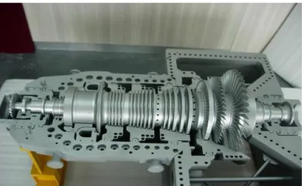
A turbine is a device that converts chemical energy into mechanical energy, specifically when a rotor of multiple blades or vanes is driven by the movement of a fluid or gas.
In the case of a steam turbine, the pressure and flow of newly condensed steam rapidly turns the rotor. This movement is possible because the water to steam conversion results in a rapidly expanding gas.
As the turbine's rotor runs, the rotating shaft can work applications, then electricity generation starts.
Section view of steam turbine.

Slide 7
Literature background of the topic
PRINCIPLES
The steam energy is converted mechanical work by expansion through the turbine. The expansion takes place through a series of fixed blades (nozzles) and moving blades each row of fixed blades and moving blades is called a stage.
The moving blades rotate on the central turbine rotor and the fixed blades are concentrically arranged within the circular turbine which the power transmit in a steam turbine is obtained by the rate of change in momentum of a high velocity jet of steam on a curved blade which is free to rotate.
Steam turbines are mostly axial flow types the steam flows over the blades in a direction Parallel to the axis of the wheel. Radial flow types are rarely used is substantially designed to withstand the steam pressure.
After in next step I will explain about working of the steam turbine and the types of turbine and then design , purpose and the advantages etc.

Slide 8
Steam
what is steam?
Steam is a vaporized as a working substance in the operation of steam turbine.
Steam Turbine.
A steam turbine is a mechanical device that extracts thermal energy from pressurized steam and converts it into rotary motion.
Its modern manifestation was invented by Sir Charles Parsons in 1884

Slide 9
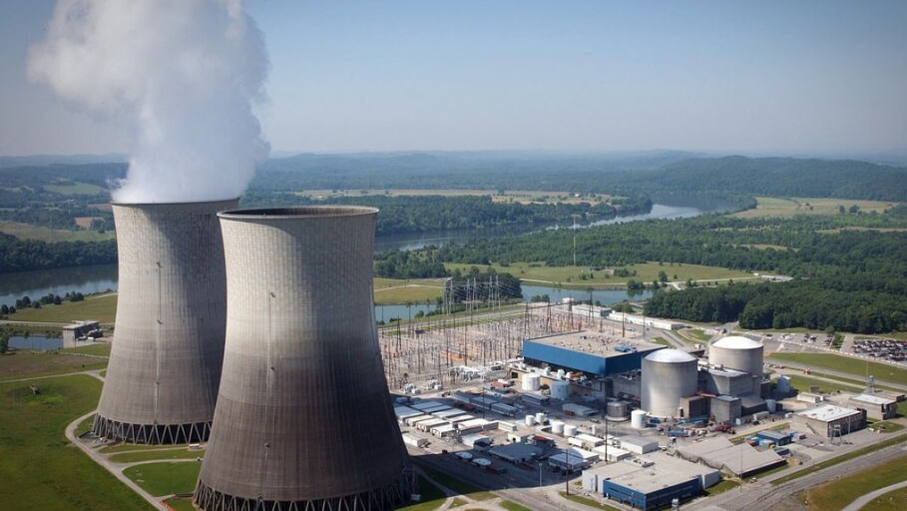
Introduction of Thermal Power Plant
A Thermal Power Plant converts the heat energy of coal into electrical energy. Coal is burnt in a boiler which converts water into steam. The expansion of steam in turbine produces mechanical power which drives the alternator coupled to the turbine. Thermal Power Plants contribute maximum to the generation of Power.
Thermal Power Plants constitute 75.43% of the total installed captive and non-captive power generation in India.
In thermal generating stations coal, oil, natural gas etc. are employed as primary sources of energy.
Vindhyachal Thermal Power Station, Madhya Pradesh with an installed capacity of 4,760MW, is currently the biggest thermal power plant in India

Slide 10
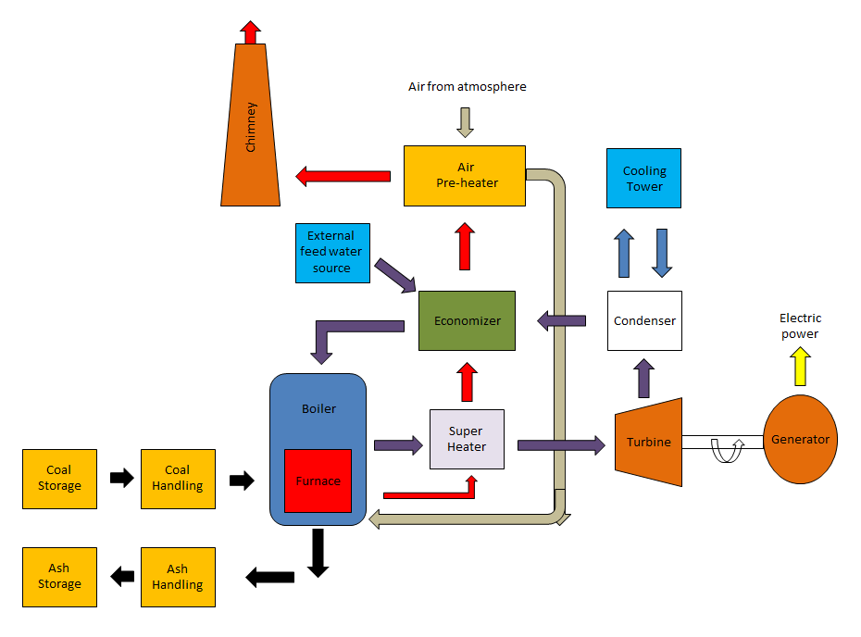
General Layout
Components of thermal Power Plant.
1. Coal Storage
2. Coal Handling
3. Boiler
4. Air-preheater
5. Economiser
6. Steam Turbine.
7. Generator
8. Ash Storage
9. Dust Collector
10. Condenser
11. Cooling Tower
12. Chimney
13. Feed Water Pump
Mainly we will discuss about the steam turbine

Slide 11
Working principle.
Firstly, the water is taken into the boiler from a water source. The boiler is heated with the help of coal.
The increase in temperature helps in the transformation of water into steam. The steam generated in the boiler is sent through a steam turbine .
The turbine has blades that rotate when high velocity stemflows across them. This rotation of turbine blades is used to generate electricity.
A generator is connected to the steam turbine. When the turbine turns, electricity is generated and given as output by the generator, which is then supplied to the consumers. Through high-voltage power lines.

Slide 12
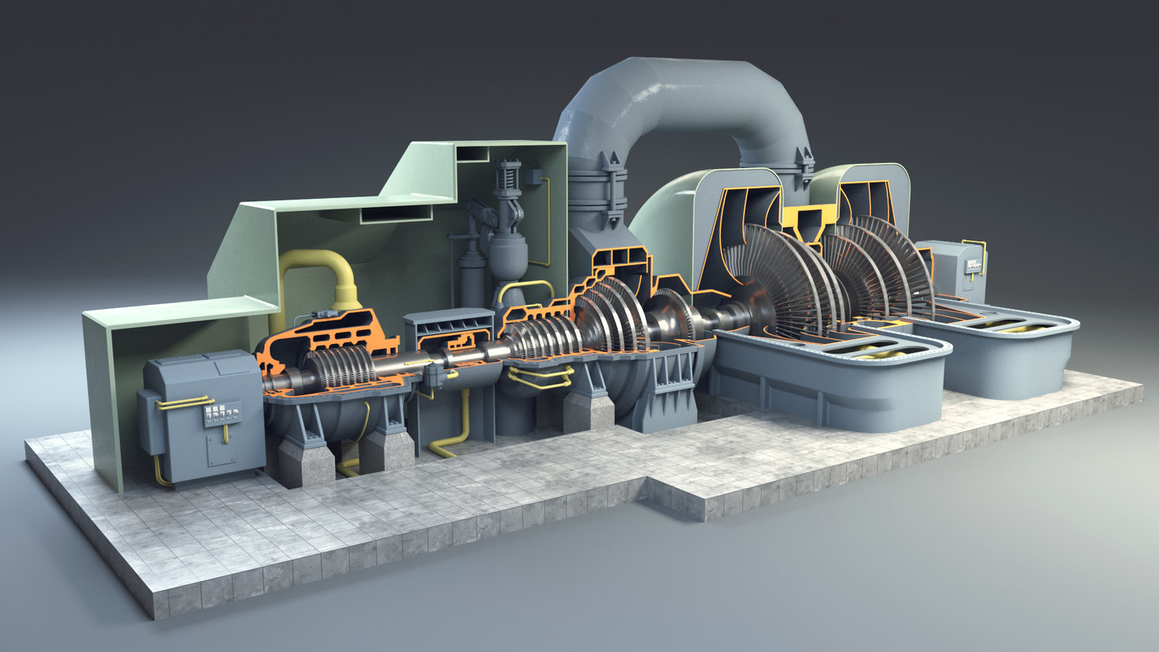
STEAM TURBINE
A turbine is a device that converts chemical energy into mechanical energy, specifically when a rotor of multiple blades or vanes is driven by the movement of a fluid or gas.
In the case of a steam turbine, the pressure and flow of newly condensed steam rapidly turns the rotor. This movement is possible because the water to steam conversion results in a rapidly expanding gas.
As the turbine's rotor runs, the rotating shaft can work applications, then electricity generation starts.

Slide 13
Parts of Steam turbine.
A) Nozzle: The nozzle expands steam of comparatively low velocity and high static pressure within considerable
increase in velocity. The nozzle is so positioned as to direct the flow of steam into the rotor passage.
b) Diffuser:
It is a mechanical device that is designed to control the characteristics of steam at the entrance to a
thermodynamic open system. Diffusers are used to slow the steam's velocity and to enhance its mixing into the
surrounding steam. In contrast, a nozzle is often intended to increase the discharge velocity and to direct the
flow in one direction.
c) Blades Or Buckets: The blades or buckets form the rotor flow passage and serves to change the direction and
hence the momentum of the steam received in the stationary nozzles.
d) Guide Or Guide blades: Often a turbine is arranged with a series of rotor flow passages. Intervening between
the blades comprising the rotor passages are rows of stationary guide blades. The purpose of this guide is to
reverse the direction of steam leaving the preceding moving blade row so that general direction of steam leaving
the preceding moving blade rows is similar. If guide blades were not provided, opposing force would be exerted
on the rotor which would largely negate each other.
e) Casing Shell Or Cylinder: The turbine enclosure is generally called the casing although the other two names
are in common use. The nozzle and guide are fixed on casing, which in addition to confining the steam serves as
support for the bearings. Sometimes the word cylinder is restricted as a cylindrical form attached to inside of the
casing to which the guides are fixed.

Slide 14
f) Shaft, Rotor, Spindle: These terms are applied to the rotating assembly which carries the blades.
g) Disc Or Wheel: The moving blades are attached to the disc which in turn is keyed to the shaft.
h) Diaphragm: The diaphragm which is fixed to the cylinder or casing contains the nozzle and serves to
confine the steam flow to nozzle passage.
i) Packing: Packing in the form of carbon rings minimizes the leaking in the annular space between the
diaphragm and shaft.
j) Thrust Bearings: Usually a combination of Kingsbury and collar types absorbs the axial forces.
k) Exhaust Hood: The exhaust hood is the portion of the casing which collects and delivers the exhaust steam
to exhaust pipe or condenser.
l) Steam Chest: The steam chest is the supply chamber from which steam is admitted to the nozzles.
m) Governor: The governing system may be designated to control steam flow so as to maintain constant speed
with load fluctuations to maintain constant pressure with variation of demand for processed steam or both.
n) Throttle Or Stop Valves: The throttle and stop valves are located in the steam supply line to the turbine. The
stop valve is hydraulically operated quick opening and shutting valves designed to be either fully opened or
shut.

Slide 15
How are Steam Turbines Classified?
Steam Turbines can be classified based on factors. Some of the important methods of steam turbine classified below:
Based on Stage Design:
Steam turbines use different stages to achieve their ultimate power conversion goal. Depending on the stages used by a particular turbine, it is classified as Impulse Turbine, or Reaction type.
Based on the Arrangement of its Main Shaft:
Depending on the shaft arrangement of the steam turbine, they may be classified as Single housing (casing), tandem compound (two or more housings, with shafts that are coupled in line with each other) and Cross compound turbines (the shafts here are not in line).
Based on Supply of Steam and Steam Exhaust Condition:
They may be classified as Condensing, Non-Condensing, Controlled or Automatic extraction type, Reheat (the steam is bypassed at an intermediate level, reheated and sent again) and Mixed pressure steam turbines (they have more than one source of steam at different pressures).
Based on Direction of Steam Flow:
They may be axial, radial or tangential flow steam turbines.
Based on Steam Supply:
Superheated steam turbine or saturated steam turbine.

Slide 16
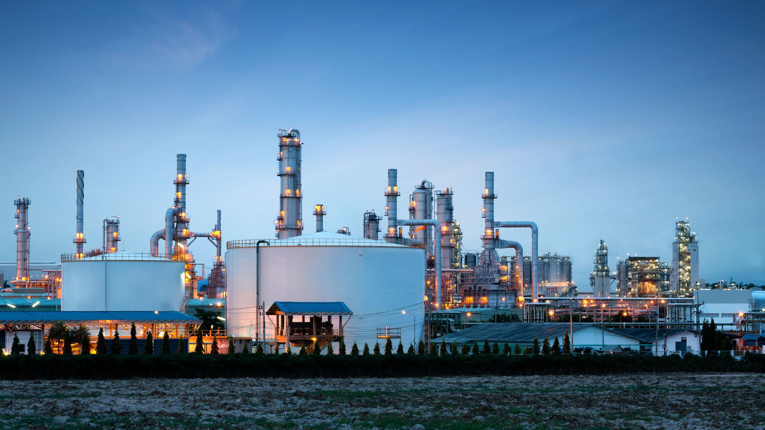
Classification of Steam turbine

Slide 17
1 Type of flow
Turbines may be classified according to the direction of steam flow in relation to the turbine wheel or drum.
1.Radial Flow.
A turbine may also be constructed so that the steam flow is in a radial direction, either toward or away from the axis. The radial turbine is not normally the preferred choice for electricity generation and is usually only employed for small output applications.
2. Axial Flow.
The great majority of turbines, especially those of high power, are axial flow. In such turbines the steam flows in a direction or directions parallel to the axis of the wheel or rotor. The axial flow type of turbine is the most preferred for electricity generation as several cylinders can be easily coupled together to achieve a turbine with a greater output.
3. Reverse Flow
In some modern turbine designs the steam flows through part of the high pressure (HP) cylinder and then is reversed to flow in the opposite direction through the remainder of the HP cylinder.
The benefits of this arrangement are outer casing joint flanges and bolts experience much lower steam conditions than with the one direction design reduction or elimination of axial(parallel to shaft) thrust created within the cylinder lower steam pressure that the outer casing shaft accommodate glands

Slide 18

2 Types of Turbine
Impulse Turbine
Reaction Turbine

Slide 19
Reaction Turbine Impulse Turbine
The vector sum of reactive and impulsive force strikes the blades fixed to the rotor.
The pressure cannot expand fully. Only when it passes through the nozzles and rests on the rotor blades, it partially expands.
The blades are asymmetrical in shape.
As the steam velocity is lower in reaction turbine, speed is much lower than impulse turbine.
To develop the same power, it requires more stages.
The blade efficiency curve is lower when compared to the impulse turbine.
The blades fixed to the rotor are stricken by an impulsive force.
When the steam passes through the nozzles, it expands completely, and its pressure remains constant.
The blades are symmetrical in shape.
Speed is high in impulse turbine, since the velocity of steam is high.
The number of stages required for producing same power is much less.
High blade efficiency curve.

Slide 21
Stages in turbine.
Single stage turbines: These turbines are mostly used for driving centrifugal compressors, blowers and other similar machinery.
Multistage Impulse and Reaction turbines: They are made in a wide range of power capacities varying from small to large.

Slide 22
Turbine Efficiency
To maximize turbine efficiency the steam is expanded, doing work, in several stages. These stages are characterized by how the energy is extracted from them and are known as either impulse or reaction turbines.
Most steam turbines use a mixture of the reaction and impulse designs: each stage behaves as either one or the other, but the overall turbine uses both. Typically, higher pressure sections are reaction type and lower pressure stages are impulse type.

Slide 23
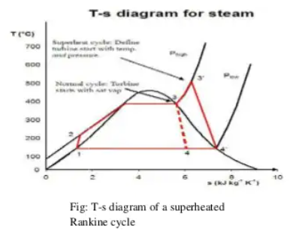
Thermodynamic Analysis.
The steam turbine operates on basic principles of thermodynamics using the part 3-4 of the Rankine cycle shown in the adjoining diagram. Superheated vapor (or dry saturated vapor. depending on application) enters the turbine, after it having exited the boiler, at high temperature and high pressure.
The high heat/pressure steam is converted into kinetic energy using a nozzle (a fixed nozzle in an impulse type or the fixed blades in a reaction type turbine).
Once the steam has exited the nozzle it is moving at high velocity and is sent to the blades of the turbine. force is created on the blades due to the pressure of the vapor on the blades causing them to move.

Slide 24
Turbine Selection
In all fields of application, the competitiveness of a turbine is a combination of several factors.
Efficiency.
Life.
Power density (power to weight ratio).
Direct operation
cost Manufacturing and maintenance costs.

Slide 25
Steam Turbine Applications
The Steam turbines of today are mostly used in the power production field.
Steam turbines are used to efficiently produce electricity from solar, coal and nuclear power plants owing to the harmlessness of its working fluid, water/steam, and its wide availability.
Modern steam turbines have come a long way in increasing efficiency in performance and more and more efforts are being made to try and reach the ideal steam turbine conditions, though this is physically impossible
Almost every power plant in the world, other than hydro electric power plants, that use turbines that run on water. , use steam turbines for power conversion.
With all the scientific advancement in power generation being attributed to them, steam turbines really have changed the way the world moves.

Slide 26
Steam turbines are devices which convert the energy stored in steam into rotational mechanical energy. These machines are widely used for the generation of electricity in several different cycles, such as:
Rankin cycle
The cycle consists of four processes:
1 to 2: Isentropic expansion (Steam turbine)
2 to 3: Isobaric heat rejection (Condenser)
3 to 4:Isentropic compression (Pump)
4 to 1: Isobaric heat supply (Boiler)

Slide 27
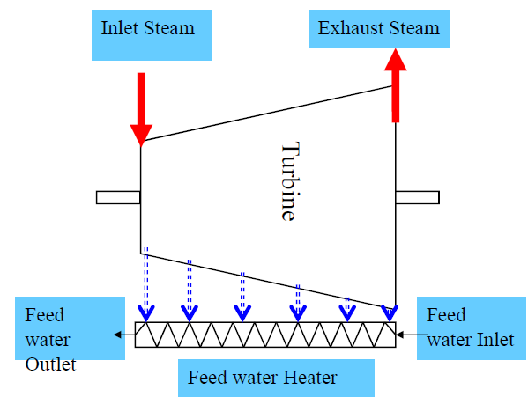
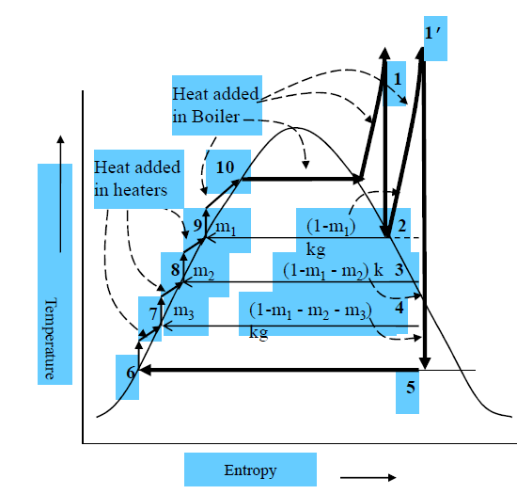
Regenerative Cycle
Regenerative Cycle helps to optimize overall Carnot Cycle Efficiency.
Temperature of water feeding to the boilers is gradually raised
Steam extracted from the turbine is used for heating gradually
Steam is suitably extracted so that the degree of superheat is minimum
Heat exchange is isothermal
Reheat Cycle
In Rankine Cycle the exhaust steam has low dryness fraction after complete expansion.
Higher the pressure more wet is the steam after isentropic expansion.
In Reheat Cycle the exhaust steam from Turbine is sent to the boiler (re-heater) and superheated.
The re-heated steam is again admitted into the turbine for further expansion.
There can be more than one Reheat stage.

Slide 28
Utility Steam Turbine Applications
Applications for utility Steam Turbines are applied for control of straight condensing, reheat and non-reheat steam turbines up to 300MW. These upgrades may include integrated generator control for generator protection and excitation/ AVR upgrades, utilizing the latest commonly available industry-standard digital equipment.
Industrial application of steam turbine
Applications of Industrial Steam Turbines cover all straight condensing, non-condensing, and automatic extraction steam turbines. Specific design features are incorporated to address control issues often unique to process plants including paper mills, oil refineries, chemical plants, and other industrial applications, generator and mechanical drive.
Some of the world’s largest turbines manufacturing companies that are seeing the rewards of research and steam turbine advances are coming together to develop highly efficient turbines.
The collaboration of Mitsubishi Heavy Machinery and General Electric Energy (GE Energy) for the conceptualization and design of a highly efficient “next- generation” steam turbine for its inception in combined cycle gas turbine power plants recently has further proved that there is still a lot to be achieved in steam turbine related research and development, and that the scope for improvement can be much higher.

Slide 29
How Can A Steam Turbine Be Improved?
A steam turbine has thousands of miniature components.
From the gigantic blades that drive the rotor, to the bearings and nuts that keep the machine in place, the steam turbine scope for improvement and effective design of every part plays a significant role in improving the turbine’s overall efficiency.
Some of the areas where a lot of research is going into are those such as nozzle design, aerodynamic blade design, heat transfer mechanisms, part cooling, fabrication and part machining, pipe flow mechanisms, metallurgy etc.
Choosing proper materials for the different steam turbine components and parts is also an important aspect of design.
The use of different lightweight yet strong and thermally resistant alloys to make steam turbine blades and moving parts is of very high importance.
This also brings about the issue that the material should be as free from erosion as possible and should not succumb to rust and other chemical changes while under operation.

Slide 30
THANK YOU

